Slide 1

Advertising Principles

Slide 2
Learning Outcomes
Provide an introduction to advertising—its role, key components, and key players.
Define advertising’s role in marketing including key players and new developments
Explain whar are the most important types of advertising
Examine how advertising has evolved, and how these developments affected current advertising practice.
Examine advertising’s relationship to society including regulations and ethics in advertising.

Slide 3
What is Advertising ?
Advertising Paid, non- personal communication through various media about a business firm, not-for-profit organization, product, or idea by a sponsor identified in a message that is intended to inform or persuade members of a particular audience.
A complex form of communication using objectives and strategies to impact consumer thoughts, feelings, and actions
A form of marketing communication (all the techniques marketers use to reach their customers and deliver their messages)

Slide 4
Factors that define Advertising
Paid communication
Sponsor is identified
Tries to inform or persuade
Reaches a large audience
Message conveyed through many different kinds of largely nonpersonal mass media
Main Principle
An effective advertisement is one that can be proven to meet its objectives.

Slide 5
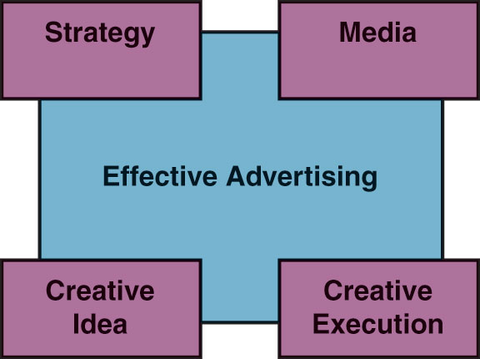
Four components of Effective Advertising

Slide 6

1. Advertising Strategy
The strategy is the logic and planning behind the ad that gives it direction.
Advertisers develop ads to meet objectives.
Advertisers direct ads to identified audiences.
Advertisers create a message that speaks to the audience’s concerns.
Advertisers run ads in the most effective media.

Slide 7

2. The creative concept
The creative concept is the central idea that grabs the consumer’s attention and sticks in the memory.
Planning strategy requires creative problem solving.
Research involves creativity.
Buying and placing ads requires creative thinking.

Slide 8
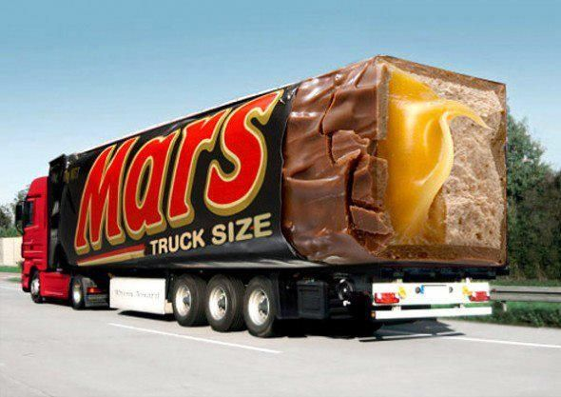
3. The creative execution
Effective ads are well executed reflecting the highest production values in the industry.
Clients demand the best production the budget allows.

Slide 9

4. The media planning
Television, Internet, magazines, newspapers and other media are used to reach a broad audience.
Deciding how to deliver the message requires creativity.
Main Principle
In advertising “how” you say something and “where” you say it is just as important as “what” you say.

Slide 10
The roles of Advertising

Slide 11
Roles of Advertising
Marketing
Communication
Economic
Societal

Slide 12

Roles of Advertising
Marketing
1. The Marketing Role
Marketing is satisfying customer wants and needs by providing products (goods, services, and ideas).
The marketing department is responsible for selling the product using the 4 Ps (product, price, place/distribution, and promotion) and brand development.

Slide 13

Roles of Advertising
Communication
2. The Communication Role
Advertising is a message to a consumer about a product, designed to create a response. It is also a form of marketing communication.
Advertising uses mass communication to transmit product information to connect buyers and sellers in the marketplace.

Slide 14

Roles of Advertising
Economic
3. The Economic Role
Since it reaches large groups of people, advertising makes marketing more cost-efficient if well executed.
Advertising creates a demand for a brand using hard sell (persuading) and soft sell (image building) techniques.

Slide 15

Roles of Advertising
Societal
4. The Societal Role
Informs consumers about innovations and how to use them.
Helps us compare products and features
Mirrors fashion and design trends and helps shape consumer self-image
Presents images about diversity in our world

Slide 16
The types of Advertising

Slide 17
Types of Advertising
Brand Advertising
Institutional Advertising
Direct Response
Non-Profit Advertising
Public Service Advertising

Slide 18
The Objectives of Advertising

Slide 19
Objectives of Advertising
Inform
Persuade
Remind
Informative
advertising
Promotion that seeks to develop initial demand for a good, service, organization, person, place, idea, or cause.
Persuasive
advertising
Promotion that attempts to increase demand for an existing good, service, organization, person, place, idea, or cause
Reminder
advertising
Advertising that reinforces previous promotional activity by keeping the name of a good, service, organization, person, place, idea, or cause before the public

Slide 20


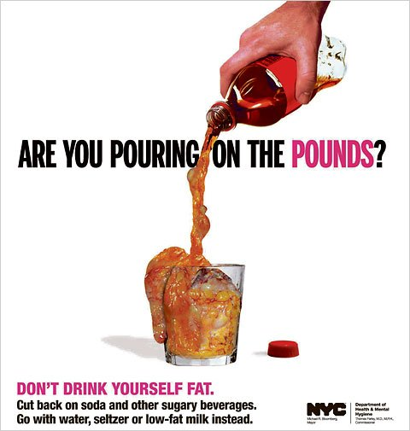
Informative
Persuasive
Reminder

Slide 21
The Key players in Advertising

Slide 22
Key players in advertising
The
advertiser
The
Agency
The
Media
Suppliers
Wants to send out a message about its business
Initiates effort by identifying a problem that advertising can solve
Selects the target audience, sets the budget, and approves the ad plan
Agencies have the strategic and creative expertise, media knowledge, talent, and negotiating abilities to operate more efficiently than the advertiser
Media are channels of communication that carry the message to the audience.
Group of service organizations that assist advertisers, agencies, and media in creating and placing ads by providing specialized services
Artists, writers, photographers, directors, producers, printers, freelancers, and consultants

Slide 23
Key players in advertising
The Audience
People to whom an ad is directed—their responses determine if advertising is effective.
Targeting is the process of identifying the people in the desired audience.
Interactive technology allows ads to be customized to the target audience’s individual needs.

Slide 24
Advertising Strategies

Slide 25
Advertising Strategies
Comparative
Testimonials
Interactive
Comparative advertising
Emphasizes messages with direct or indirect promotional comparisons between competing brands
Celebrity Testimonials
Use of celebrity spokespeople for products Can build brand equity but can hurt brand if celebrity is hit by scandal
Interactive
advertising
Involves two-way promotional messages transmitted through communication channels that induce message recipients to participate actively in the promotional effort

Slide 26



Advertising Strategies
Comparative
Testimonials
Interactive

Slide 27
Advertising Principles
The End

